Slide 1
Pacific County Weekly
COVID-19 Data 10/13/2021

Slide 2
Pacific County Weekly COVID 19 Case Data
Pacific County Case Data Summary
Cases (Total)
Active Cases
New cases this week
New cases over 14 days
Total Hospitalizations
New hospitalizations this week
Deaths (total)
Case rate per 100,000 population over 14 days
9/29/2021
1850
87
83
158
98
8
28
712
10/6/2021 | 10/13/2021
1904 | 1958
91 | 43
54 | 54
137 | 108
103 | 108
5 | 5
29 | 29
665 | 499
Updated 10/13/2021

Slide 3
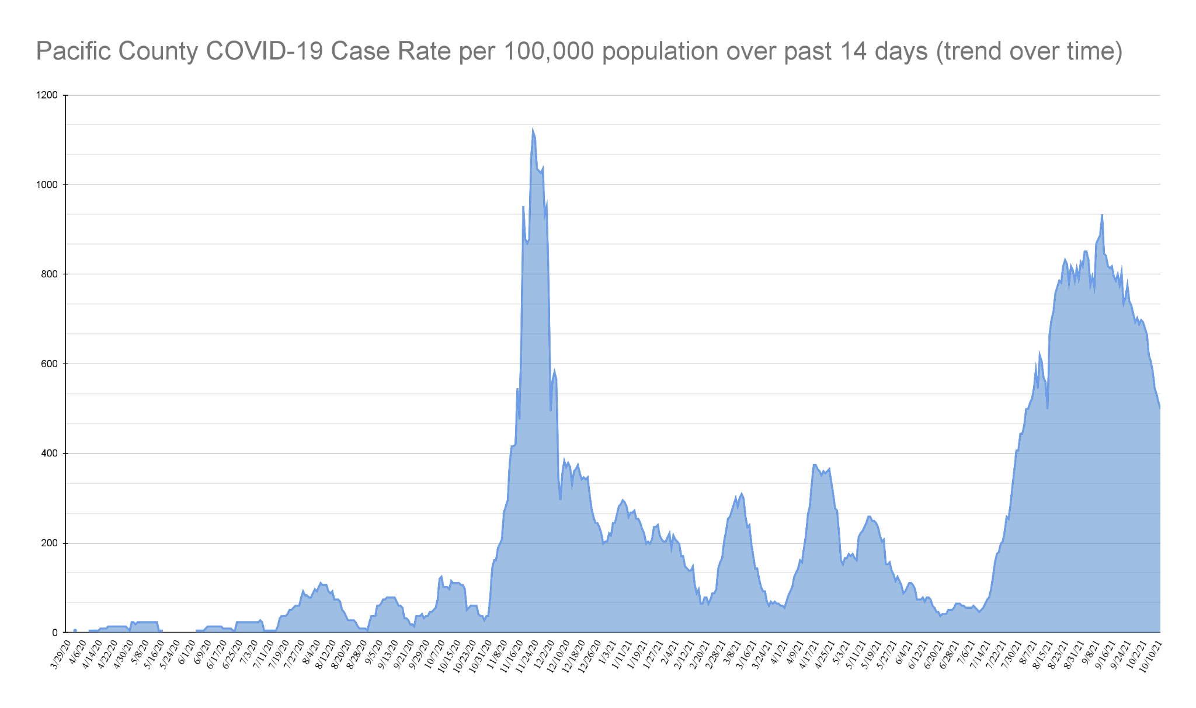
Updated 10/13/2021

Slide 4
Case Rates: Fully vaccinated vs not fully vaccinated (since Jan 1, 2021)
9/29/2021 |  |  | 10/6/2021 |  |  | 10/13/2021
205 | = | 16.3% | 230 | = | 17.6% | 248 | = | 18.2%
1256 |  |  | 1310 |  |  | 1364
1051 | = | 83.7% | 1080 | = | 82.4% | 1116 | = | 81.8%
1256 |  |  | 1310 |  |  | 1364
205 | = | 1.9% | 230 | = | 2.1% | 248 | = | 2.2%
10739 |  |  | 10831 |  |  | 11023
Proportion of cases in people since January 1st who are fully vaccinated | Cases in People who are fully vaccinated ------------->
 | Total cases since January 1st ----------------------------->
Proportion of cases in people since January 1st who are NOT fully vaccinated | Cases in people who are NOT fully vaccinated ------>
 | Total cases since January 1st ----------------------------->
Breakthrough case rate (% of people who are fully vaccinated who test positive for COVID 19) | Cases in People who are fully vaccinated ------------->
 | Total # of people who are fully vaccinated ------------->

Slide 5
Age
0-9
10-19
20-29
30-39
40-49
50-59
60-69
70+
Incomplete data
10/13/2021
159
282
233
312
284
242
216
205
1933
Pacific County
COVID-19 Cases
by Age Group
Updated 10/13/2021

Slide 6
Case Rate by Zip Code | 10/13/2021
Bay Center (98527) | 15
Chinook (98614) | 34
Ilwaco (98624) | 85
Long Beach (98631 | 238
Lebam (98554) | 2
Naselle (98638) | 119
Nahcotta (98637) | 5
Menlo (98561) | 2
Ocean Park (98640) | 211
Oysterville (98641) | 6
Seaview (98644) | 47
Raymond (98577) | 815
South Bend (98586) | 295
Tokeland (98590) | 18
Grayland (98547) | 37
Incomplete data | 29
Pacific County
Cases by Zip Code
Confirmed case count is specific to each zip code.
Represents permanent residence of Pacific County COVID-19 cases.
Not a representation of where COVID-19 exposure or transmission occurred.
Updated 10/13/2021

Slide 7
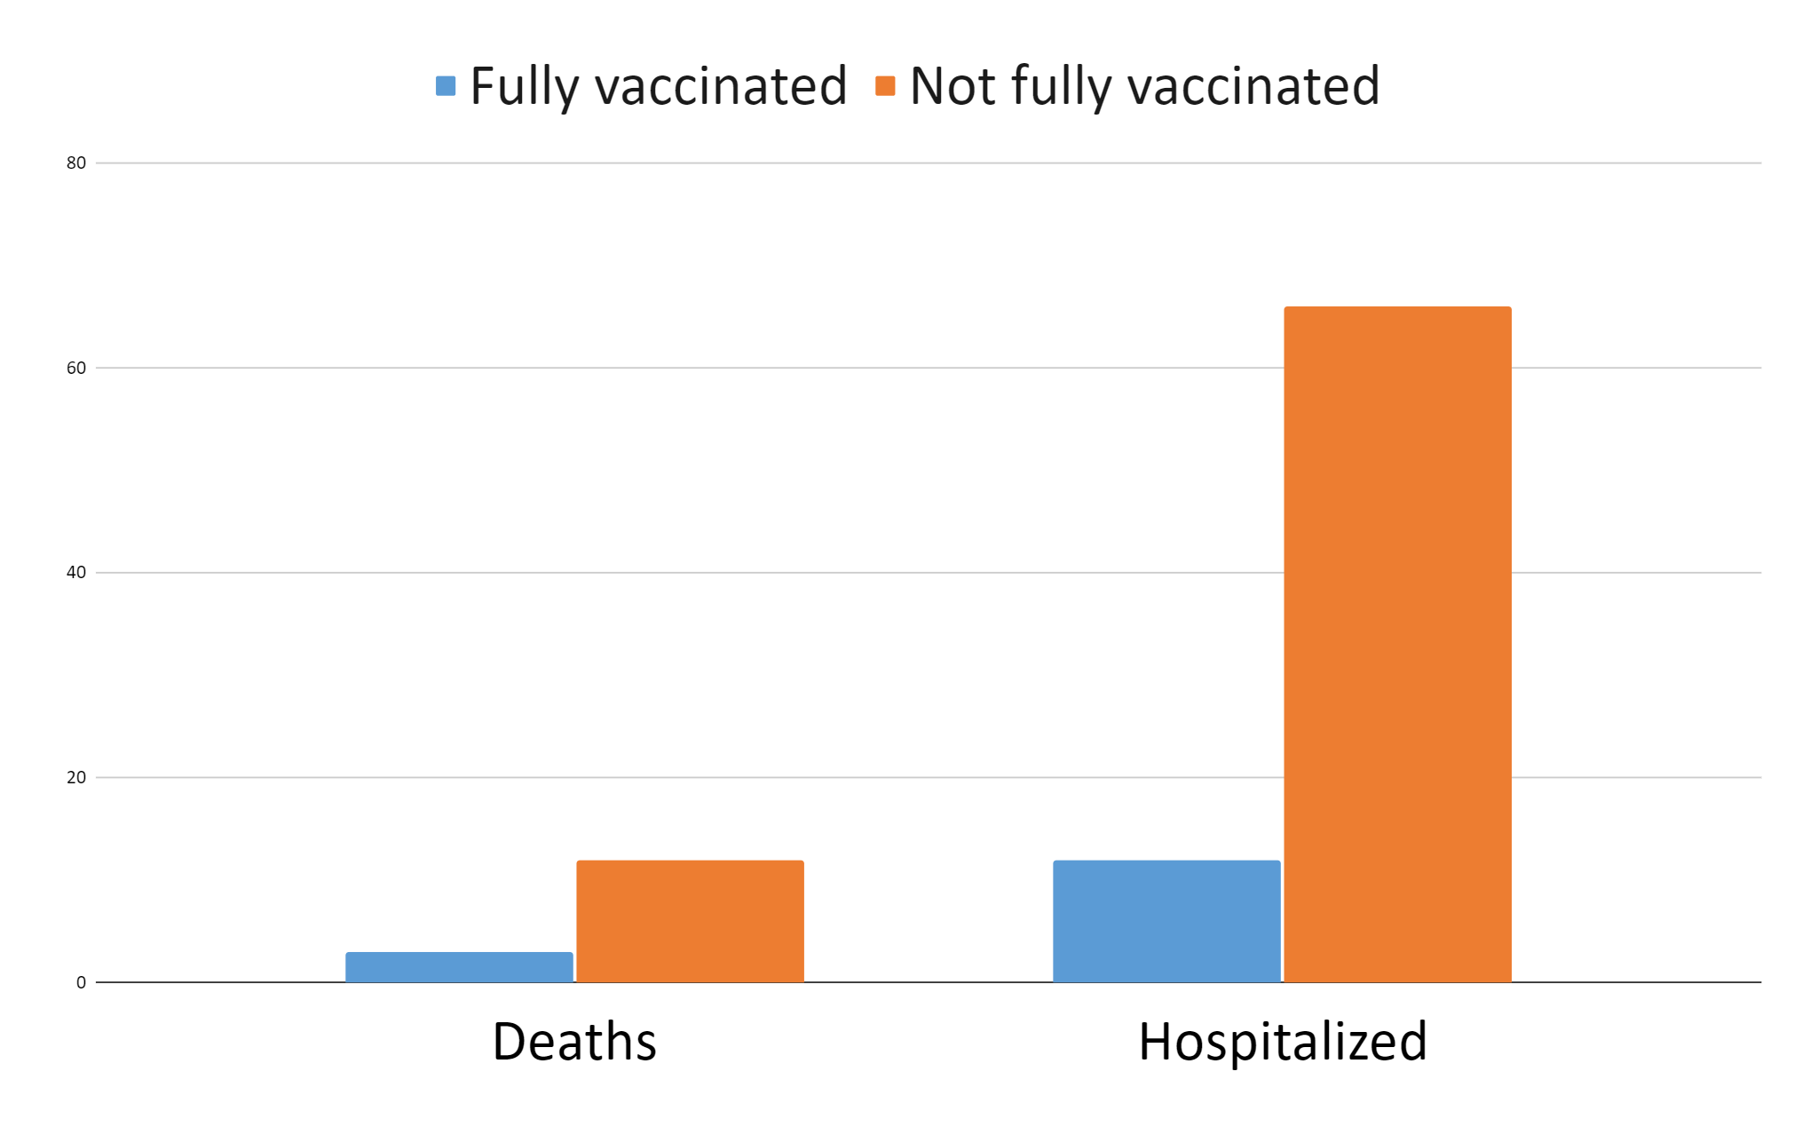
Deaths and Hospitalizations due to COVID-19 in Pacific County
March 1, 2021- October 6, 2021

