Slide 1
Pacific County Weekly
COVID-19 Data 10/06/2021

Slide 2
Pacific County Weekly COVID 19 Case Data
Pacific County Case Data Summary
Cases (Total)
Active Cases
New cases this week
New cases over 14 days
Total Hospitalizations
New hospitalizations this week
Deaths (total)
Case rate per 100,000 population over 14 days
9/22/2021
1767
72
75
168
90
6
27
776
9/29/2021 | 10/6/2021
1850 | 1904
87 | 91
83 | 54
158 | 137
98 | 103
8 | 5
28 | 28
712 | 665
Updated 10/06/2021

Slide 3
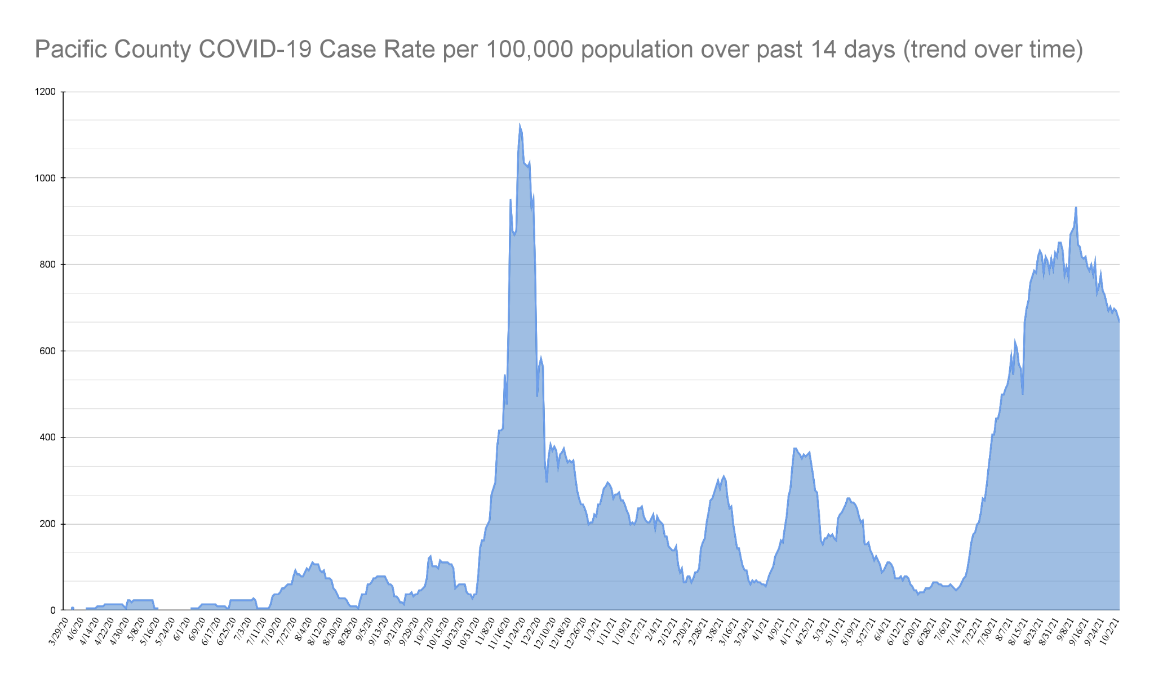
Updated 10/06/2021

Slide 4
Case Rates: Fully vaccinated vs not fully vaccinated (since Jan 1, 2021)
9/22/2021 |  |  | 9/29/2021 |  |  | 10/6/2021
177 | = | 15.1% | 205 | = | 16.3% | 230 | = | 17.6%
1173 |  |  | 1256 |  |  | 1310
996 | = | 85% | 1051 | = | 84% | 1080 | = | 82%
1173 |  |  | 1256 |  |  | 1310
177 | = | 1.7% | 205 | = | 1.9% | 230 | = | 2.1%
10678 |  |  | 10739 |  |  | 10831
Proportion of cases in people since January 1st who are fully vaccinated | Cases in People who are fully vaccinated ------------->
 | Total cases since January 1st ----------------------------->
Proportion of cases in people since January 1st who are NOT fully vaccinated | Cases in people who are NOT fully vaccinated ------>
 | Total cases since January 1st ----------------------------->
Breakthrough case rate (% of people who are fully vaccinated who test positive for COVID 19) | Cases in People who are fully vaccinated ------------->
 | Total # of people who are fully vaccinated ------------->

Slide 5
Age
0-9
10-19
20-29
30-39
40-49
50-59
60-69
70+
Incomplete data
10/6/2021
153
273
228
307
279
237
209
197
21
Pacific County
COVID-19 Cases
by Age Group
Updated 10/06/2021

Slide 6
Case Rate by Zip Code | 10/06/2021
Bay Center (98527) | 13
Chinook (98614) | 34
Ilwaco (98624) | 82
Long Beach (98631 | 229
Lebam (98554) | 2
Naselle (98638) | 116
Nahcotta (98637) | 5
Menlo (98561) | 2
Ocean Park (98640) | 202
Oysterville (98641) | 6
Seaview (98644) | 46
Raymond (98577) | 791
South Bend (98586) | 294
Tokeland (98590) | 15
Grayland (98547) | 36
Incomplete data | 31
Pacific County
Cases by Zip Code
Confirmed case count is specific to each zip code.
Represents permanent residence of Pacific County COVID-19 cases.
Not a representation of where COVID-19 exposure or transmission occurred.
Updated 10/06/2021

